Slide 1
Frontend best practices – part I

Slide 2
Agenda
Theory (15 min)
Best practices – general/agnostic
Components architecture: Smart vs Dummy
Practice - demo code (30 min)
Angular components architecture
Performance example
Notes:
Practice for only one high best practice component

Slide 3
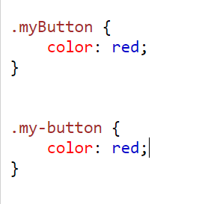
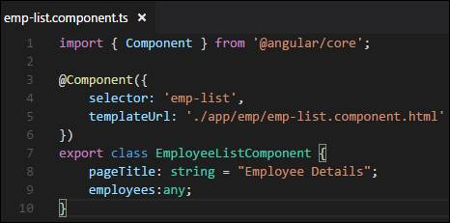
Best practices - Low impact
Naming conventions (camelCase vs PascalCase in JS or TS)
snake-case or camelCase in CSS

Slide 4
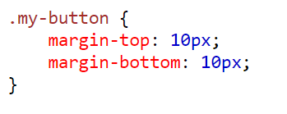
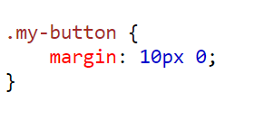
Best practices - Low impact
CSS optimizations or writing less lines

Slide 5
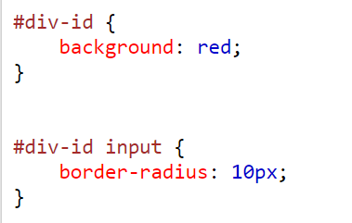
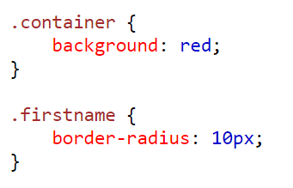
Best practices - MEDIUM impact
CSS classes over ids (too specific and cannot be reused) or tags (too general)
BEM architecture principles

Slide 6
Best practices - HIGHEST impact
Components architecture
Smart vs dumb components
Smart and presentational components (AngularUniversity)
Containers and presentational components (React/Redux community)
Managing state
React: Redux, Mobx, Hooks + Context
Vue.js: Vuex, Vue-mobx
Angular: Services + RxJs, NgRx, mobx-angular

Slide 7
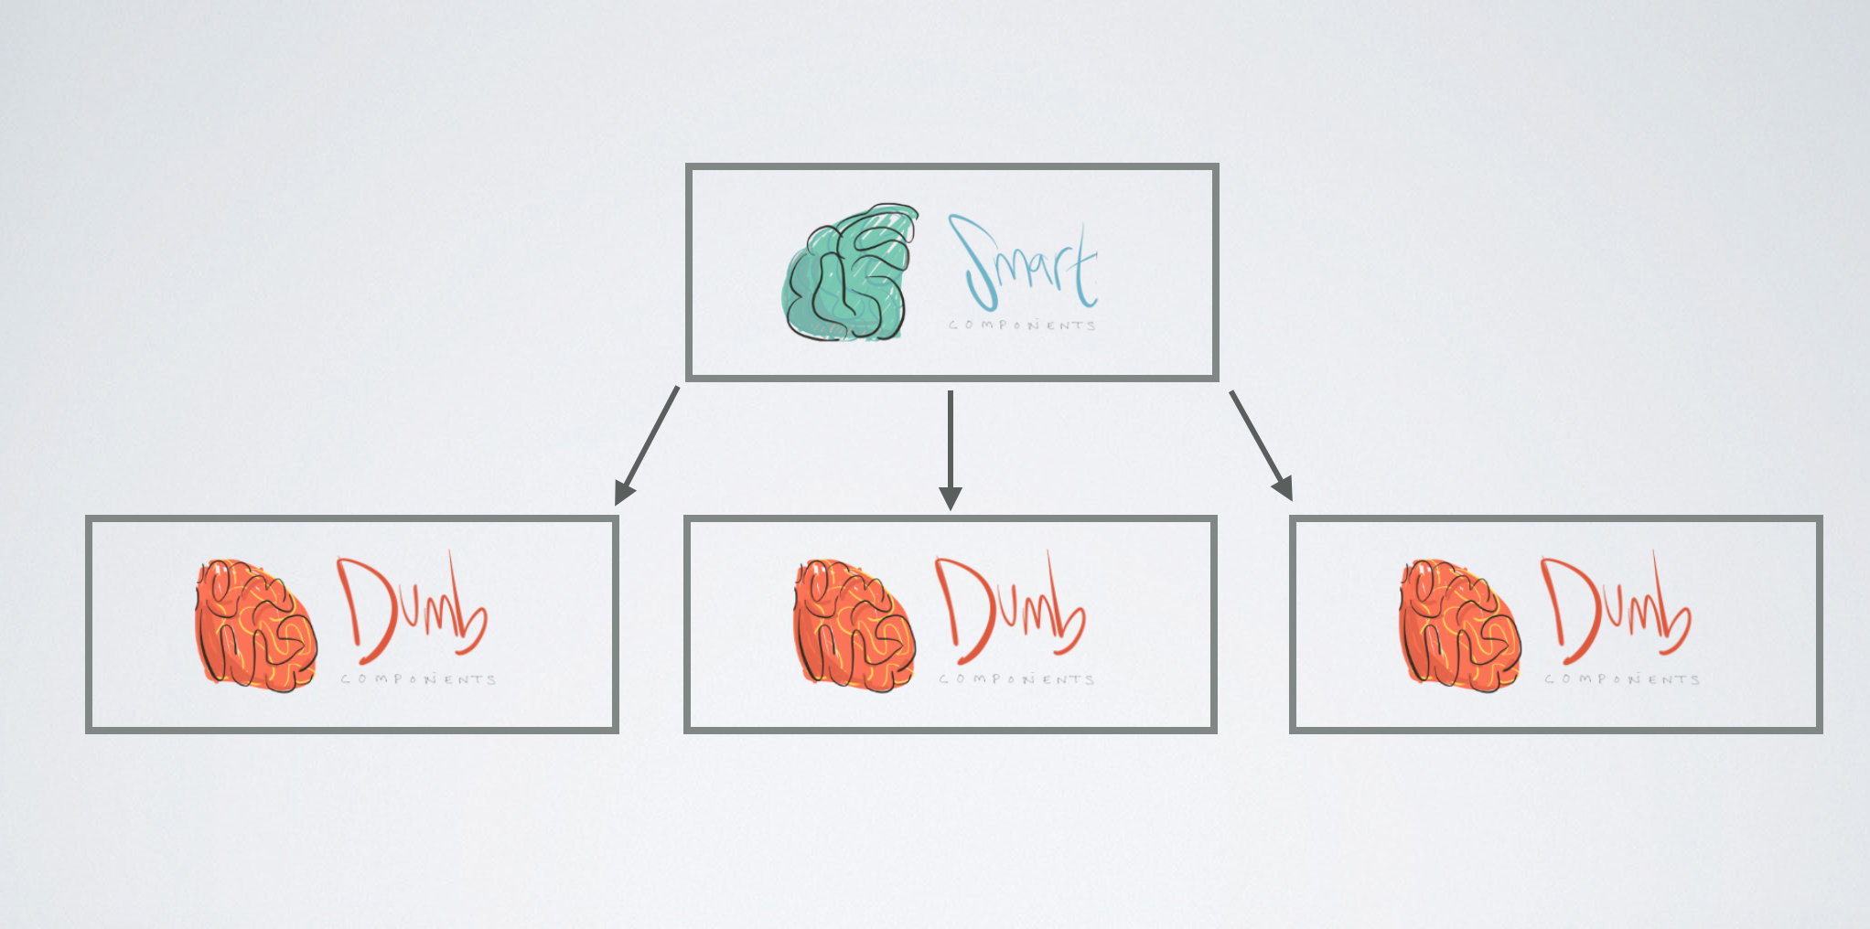
Components architecture
Notes:
Smart vs dumb components architecture propose to have the logic separated from the presentation components

Slide 8

Dumb component
Presentation code (HTML structure, CSS code and very little infrastructure code)
Only receive data to display
Stateless
No side effects
Emit events to interact with smart components
Very easy to use

Slide 9

SMART component
Do all the logic
Usually have state
Pass data to dumb components
Cannot be reused easily
Very little to no presentation code
(HTML structure or CSS code)

Slide 10

Smart vs DUMB components
PROs:
Separation between presentation and business logic core components
Easy to understand
Easy to test components
High reusable code
Extreme performance (stay tuned for the demo code)
CONs:
Hard to separate components on legacy code
Is not suitable for deep hierarchies (a lot of delegations or event propagation)
Notes:
Smart vs dumb components architecture propose to have the logic separated from the presentation components

Slide 11
Let’s practice NOW!
Notes:
Smart vs dumb components architecture propose to have the logic separated from the presentation components

Slide 12
note APP - Requirements
Notebook
Notes: Note 1 Note 2
……
Notes:
Note 1
Note 2
Notes:
Smart vs dumb components architecture propose to have the logic separated from the presentation components

Slide 13

DEMO CODE
Note app:
- Support classic load more
- Support infinite scrolling functionality
Notes:
Smart vs dumb components architecture propose to have the logic separated from the presentation components

